Slide 1
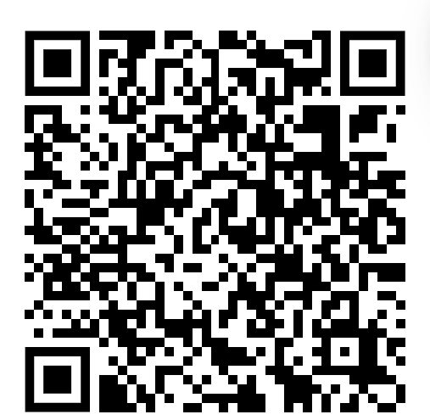
Intro to da front end

Slide 2

Announcements
We have Honeywell coming in next week again :) Good networking opportunity
Best of luck with finals coming up!

Slide 3
What is da front end?
The front-end refers to the side of a site that the public or a user sees

Slide 4
What is HTML? What is CSS?
HTML stands for HyperText Markup Language. It is a standard markup language for web page creation. It allows the creation and structure of sections, paragraphs, and links using HTML elements (the building blocks of a web page) such as tags and attributes.
CSS is responsible for stylings such as background, colors, layouts, spacing, and animations. On the other hand, JavaScript adds dynamic functionality such as sliders, pop-ups, and photo galleries. These three languages are the fundamentals of front-end development.

Slide 5
So, let’s get started~
Open up your editor and create a file. Name it whatever you want. I’ll call mine home.html
This is called internal css, aka making one file with both css and html attributes. You can also use external to put the css file and html file separately!
Now, we are ready to start coding

Slide 6
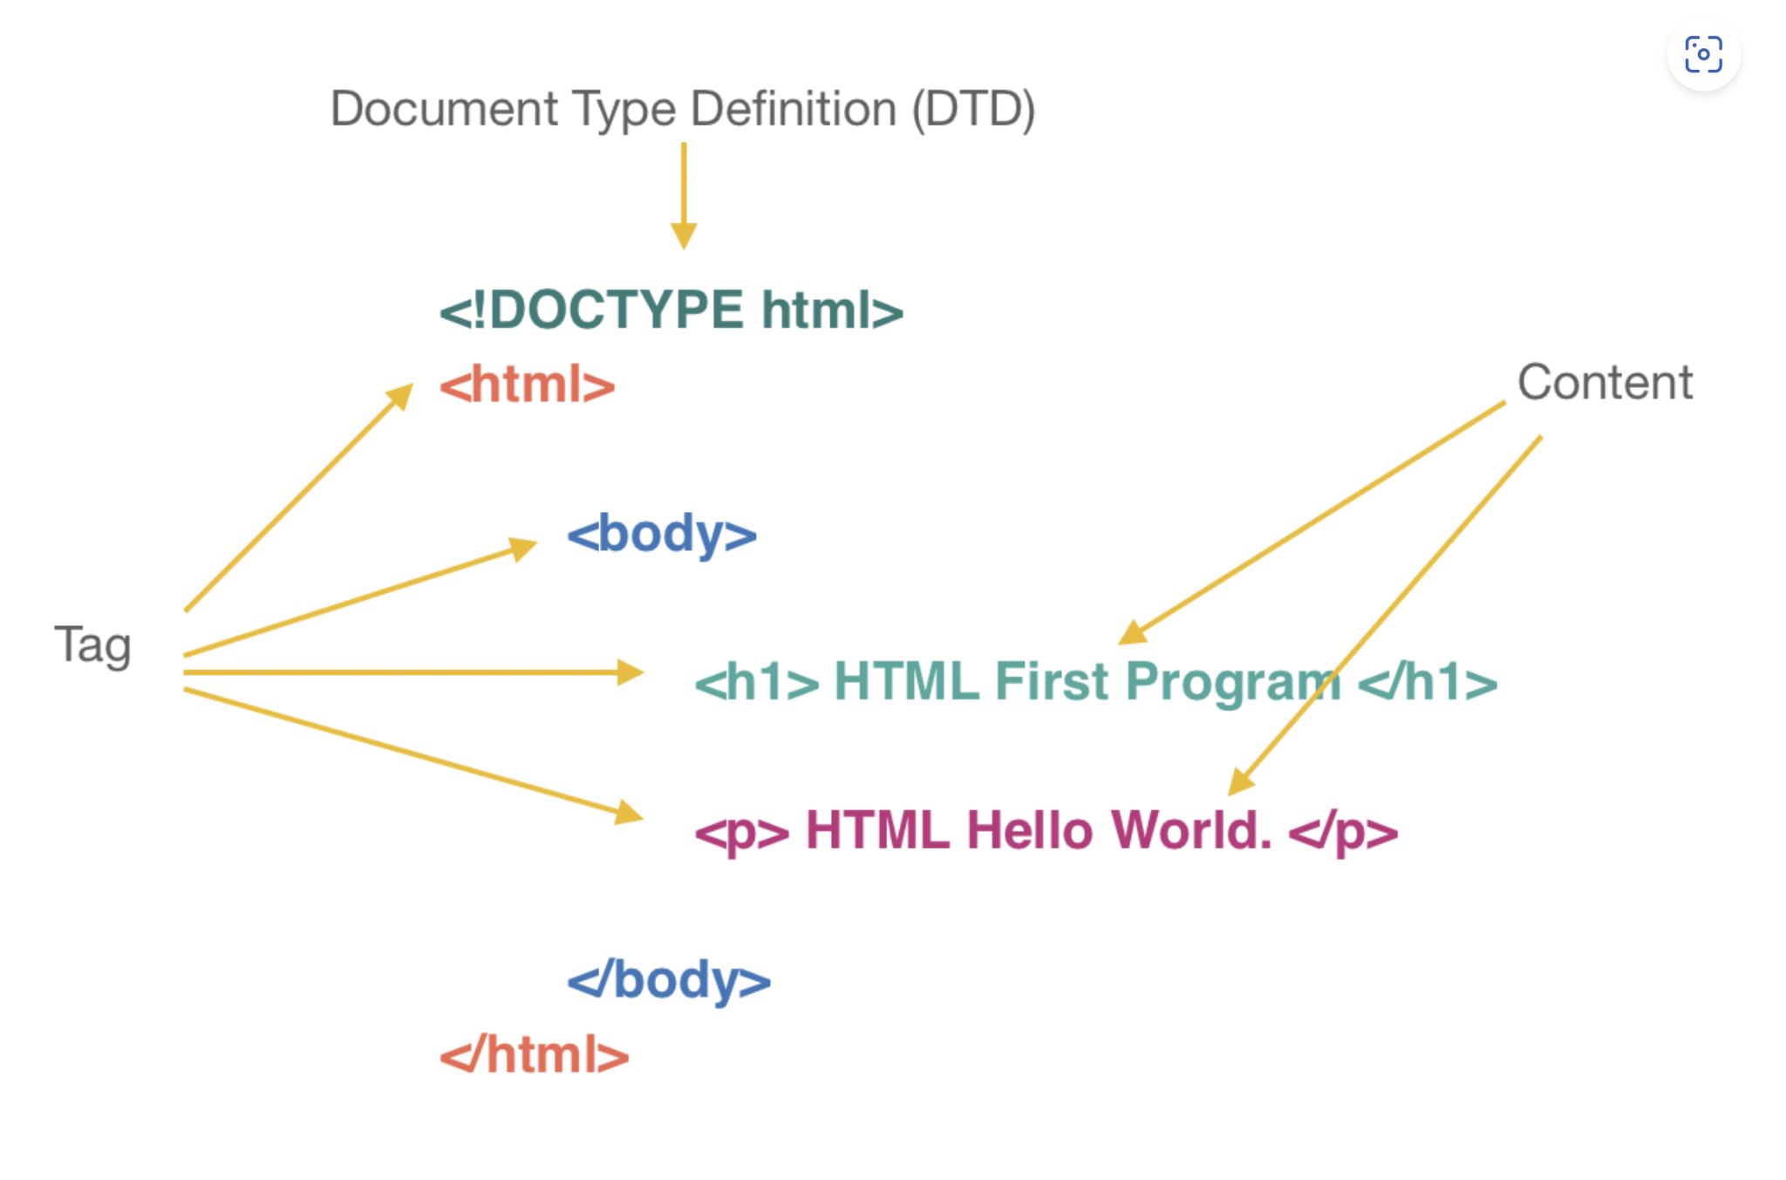
Basic syntax of html

Slide 7
Let’s structure our file first, then make a body
<html> </html>
<head> </head>
<body> </body>

Slide 8
Adding text
Type <p> Hello World! </p>
Now let’s run our file. Go to wherever it is saved and double click it.

Slide 9
Adding bold and italics
Try this now, <p> Hello <strong>World! </p>
Now, refresh your browser

Slide 10
<p> Hello <em>World! </p>

Slide 11
Add bullet points
<ul>
<li>Item <span>one</span></li>
<li>Item two</li>
<li>Item <em>three</em></li>
</ul>

Slide 12
Add links!
<a href="https://cat-bounce.com/">link</a>

Slide 13
Add an Image!
Pick an image online, any image
Copy that link, paste it where the url is in this line
<img src = "https://miro.medium.com/max/2400/1*aBC2OmywgdkeYy2wI25Niw.jpeg"/>

Slide 14
Add a button!!!
<input type="button" id="This is a button" value="Button">

Slide 15
External CSS
Create a file and name it home.css
//THIS GOES IN YOUR HTML FILE (anywhere)
<link rel="stylesheet" href="home.css">
<h1>This the title</h1>

Slide 16
Ok this goes in the css file
h1{
color:blue;
font-family: sans-serif;
text-align: right;
font-style: italic;
}

Slide 17
That’s it! Now you have the basics of creating a site
Some notes: there are SO many more functions that you can use with these
If you want to make these elements do stuff, like clicking a button and it actually does something, you would need to incorporate javascript
Now you can try creating a personal website!!

Slide 18
If you have questions, feel free to reach out!!!
Keep slaying

